Slide 1
Sampling and Link Prediction
Sassan Owssia

Slide 2
Sampling
Link prediction methods based on similarity measures are computationally heavy and take too long to run. One way to adress this issue is to sample the data in to a managable size.
Best Performing Methods
Forest Fire
Random Walk Samplimg
Jure Leskovec and Christos Faloutsos. 2006. Sampling from large graphs. In Proceedings of the 12th ACM SIGKDD international conference on Knowledge discovery and data mining (KDD '06). Association for Computing Machinery, New York, NY, USA, 631–636.

Slide 3
Forest Fire
Takes a Seed node and starts “Burning” links with a constant probability. If a link get’s burned the succeeding node has chance to burn its links. The model will eventually die out.
This Method compared to other high performing sampling methods such as RWs has a significantly shorter running time.
J. Leskovec, J. Kleinberg, and C. Faloutsos. Graphs over time: Densification laws, shrinking diameters and possible explanations. In ACM SIGKDD, 2005.

Slide 4
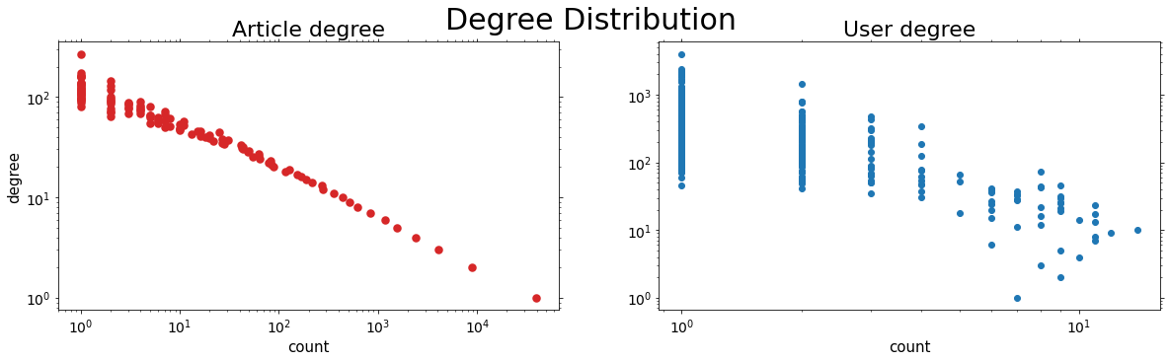
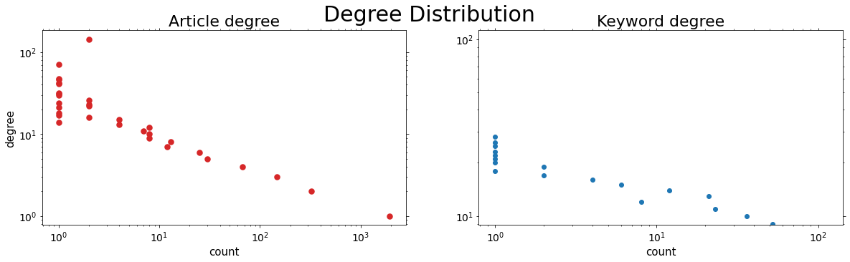
Data:
Forest Fire Sample:

Slide 5
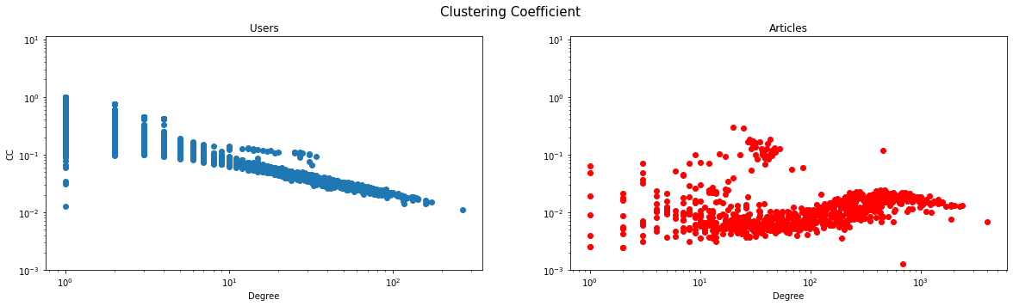
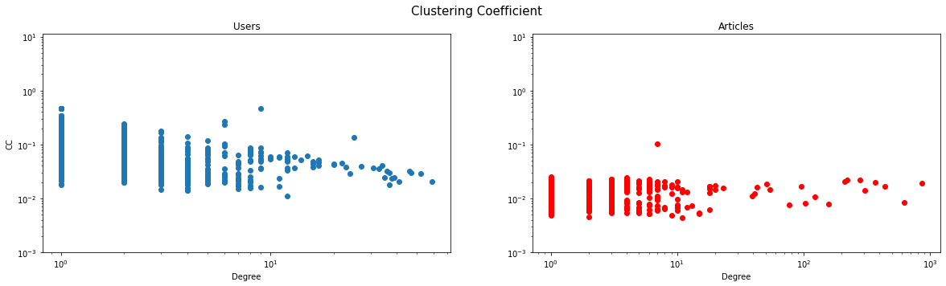
Data:
Forest Fire Sample:

Slide 6
It is clear that despite the small sample size of 5 percent of the graph size, the forest fire sample’s preserved the degree and cluster coefficient distributions.

Slide 7
Link Prediction
Jaccar
Adamic/Adar
Common Neighbor
Preferntial attachment

Slide 8
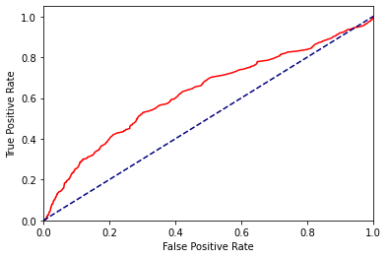
Jaccard link prediction
AUC 0.626

Slide 9
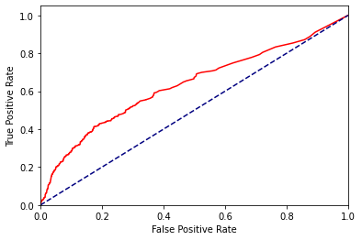
Adamic adar link prediction
AUC 0.624

Slide 10
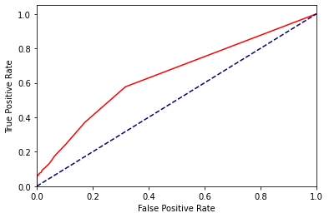
Common neighbors
AUC 0.644

Slide 11
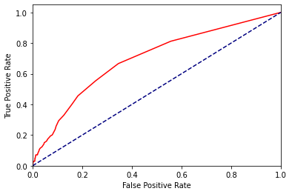
Preferential attachment
AUC 0.694
Best Result

